Slide 1

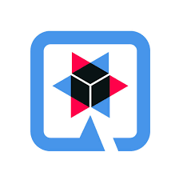
QUARKUS
MEENAKSHI SAJEEVAN
245125

Slide 2
Quarkus
Quarkus is a Kubernetes Native Java Framework tailored for GraalVM and Hotspot.
It is designed around a container’s first philosophy so you can develop an app that consumes much less memory and which is super fast.
Quarkus works on Ahead of Time compilation strategy, what it means that it will compile your code in the background before we build our application.
It allows us to use both blocking and non-blocking strategies simultaneously.
Quarkus has the reactive approach embedded in its architecture.

Slide 3
Features
Function-as-a-Service (FaaS) Runtime - When compiled to a native binary, Quarkus applications can start in under .0015 seconds.
Live Coding
Support for reactive and imperative models - Quarkus has a reactive core that supports the traditional imperative model, reactive model, or both in the same application.
Early detection of dependency injection errors

Slide 4
Why Quarkus?
Quarkus compile the code in the background before building the application.
Less memory usage and faster startup time.

Slide 5
Pros and Cons
Pros
Lots of simple documentation is available on the web since it has several communities to help developers.
The application boot time is much faster with Quarkus compared to other frameworks such as Spring Boot.
Quarkus can be directly deployed with docker.
Cons
The Graal VM installation is somewhat complicated.
The community forum does not necessarily provide solutions to all the problems one may encounter when using Quarkus.

Slide 6
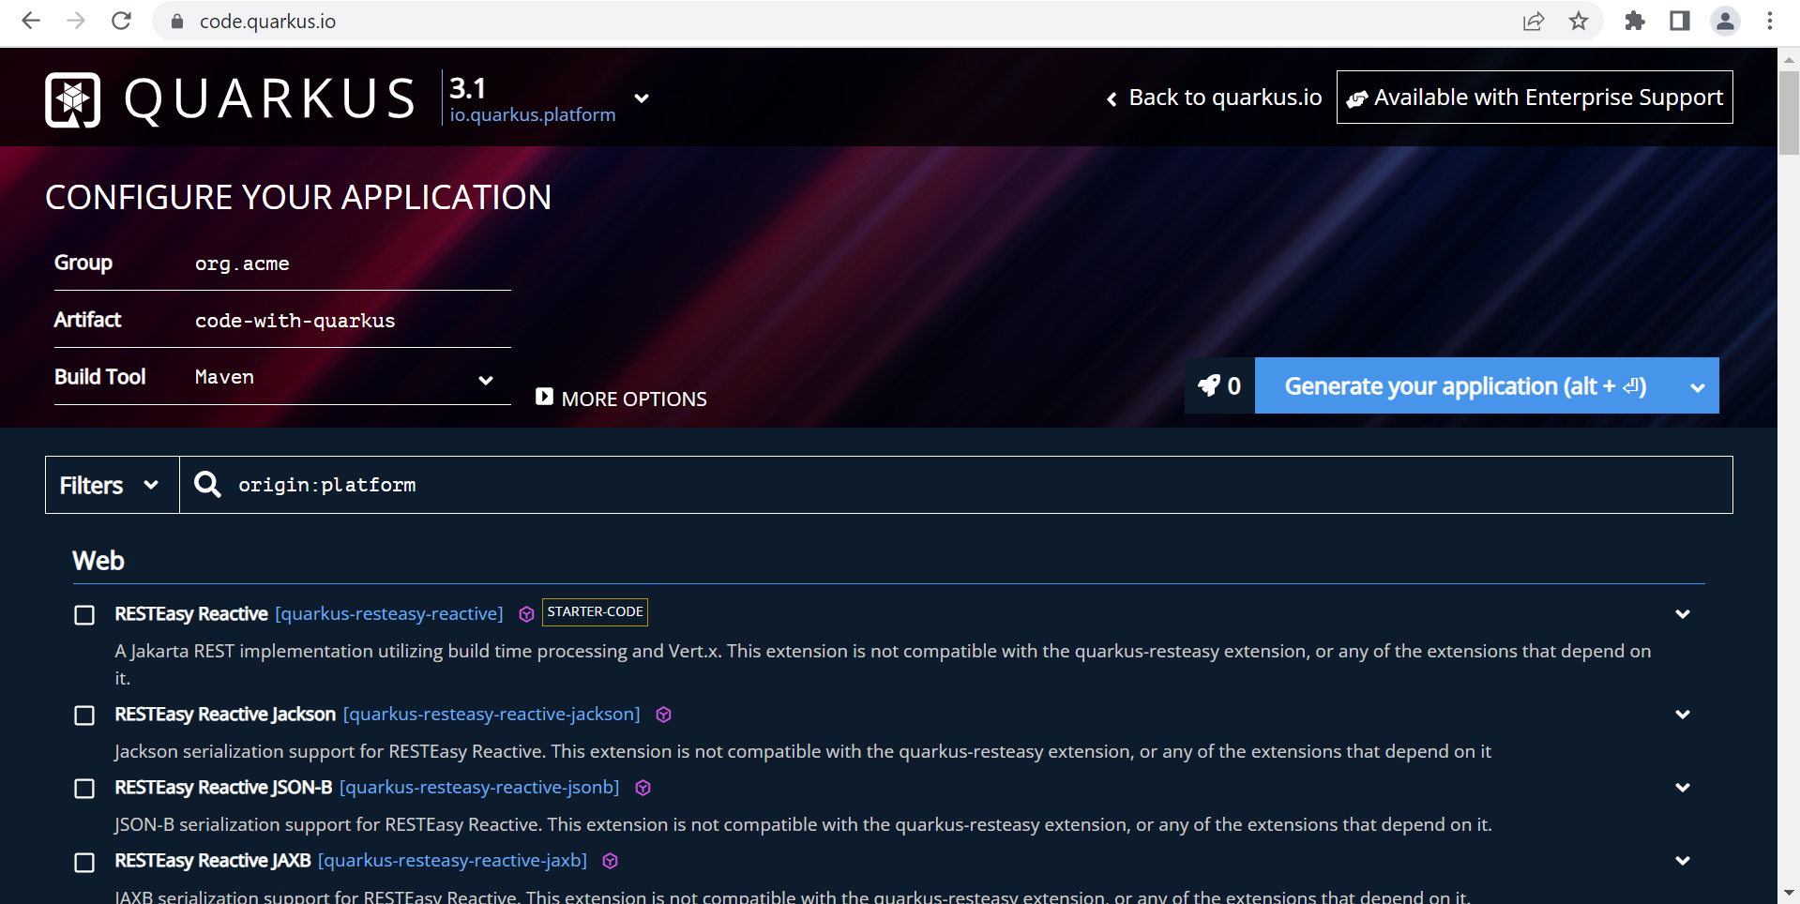

Slide 7
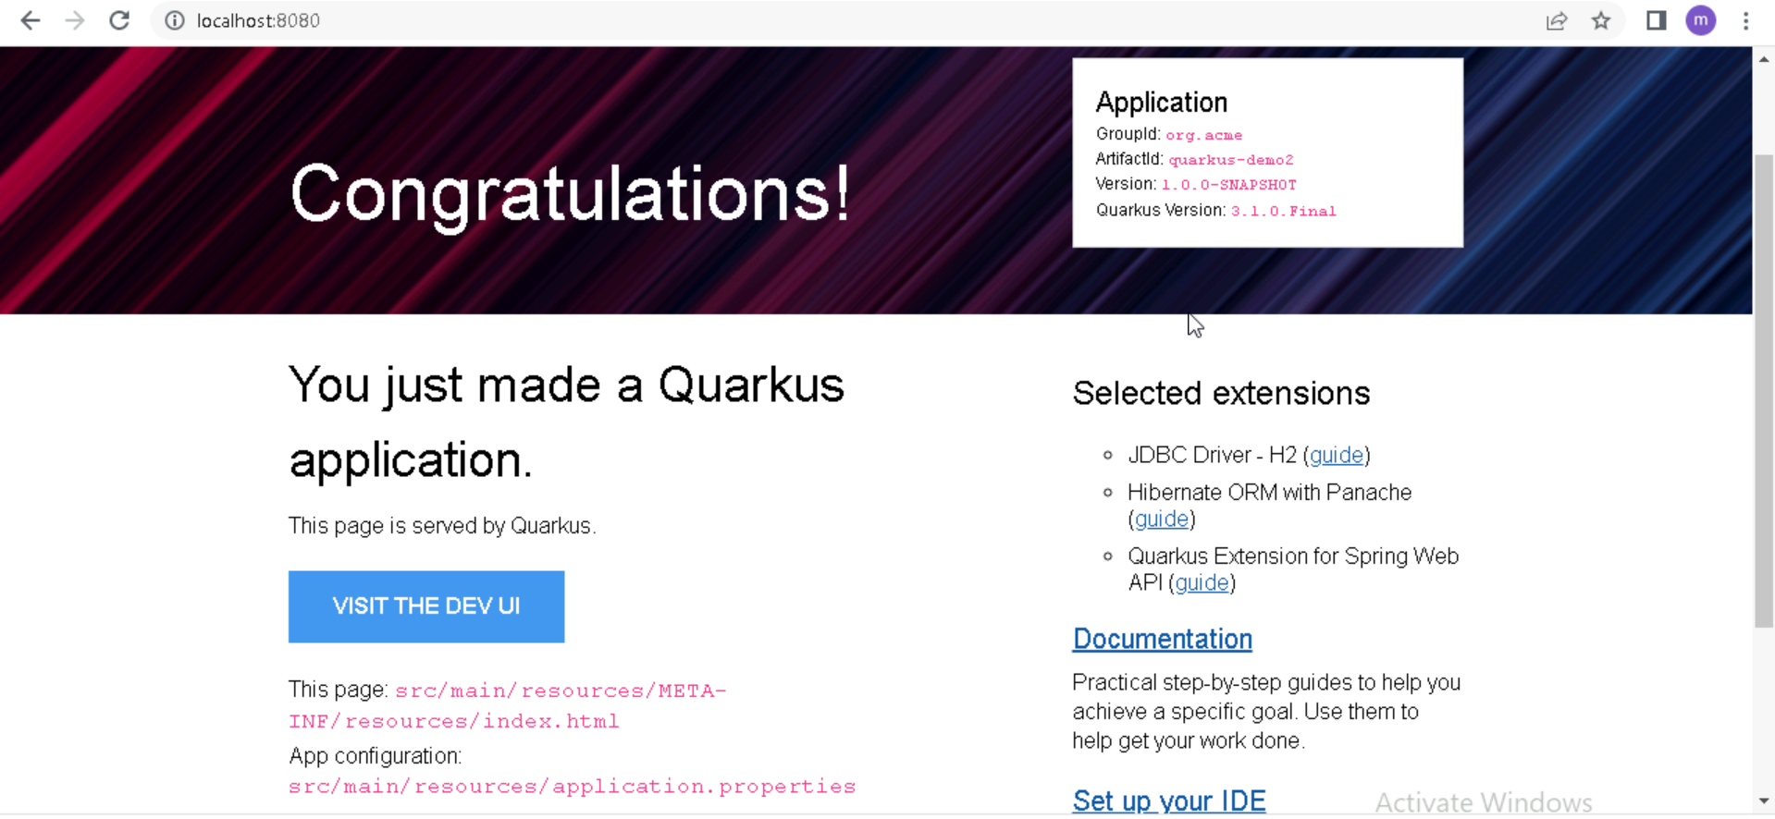

Slide 8
Commands to Deploy With Docker
mvn package
docker build –f src/main/docker/Dockerfile.jvm –t quarkus/quarkus-demo-jvm .
docker images
docker run –i –rm –p 8080:8080 quarkus/quarkus-demo-jvm
docker ps
docker kill container Id

Slide 9
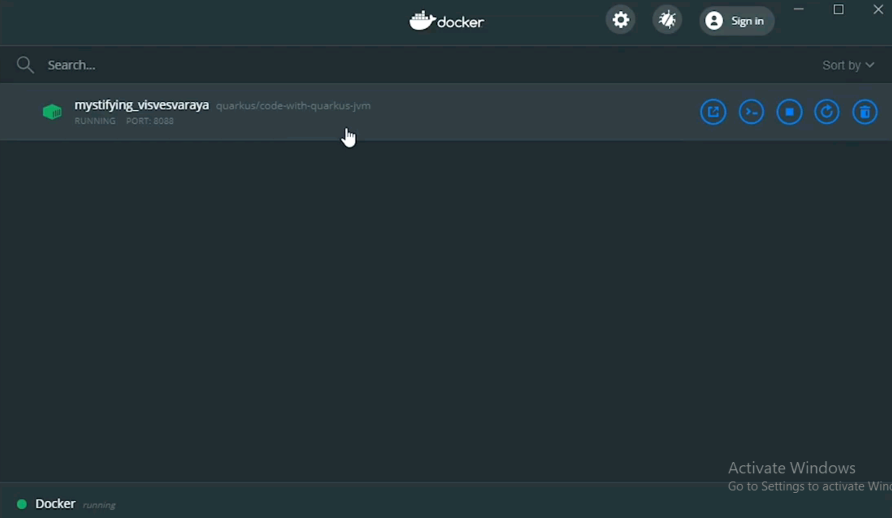

Slide 10
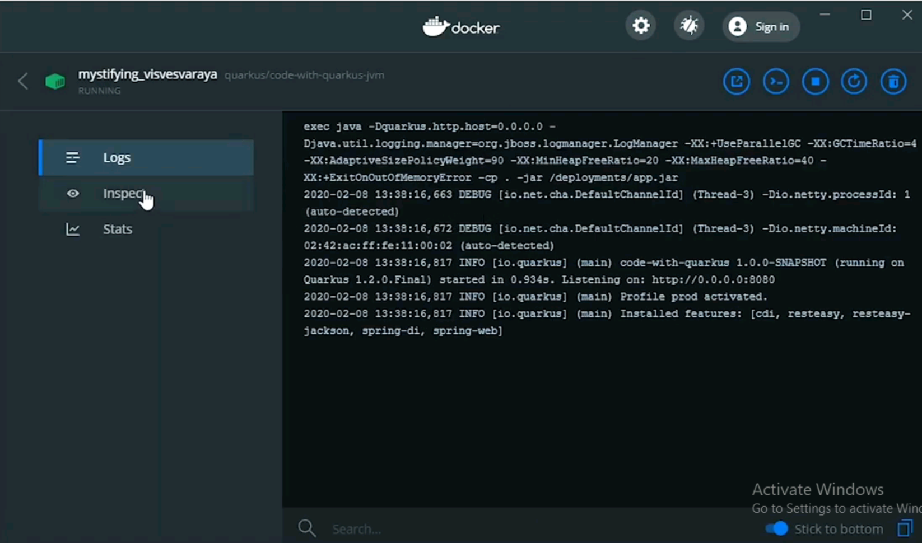

Slide 11
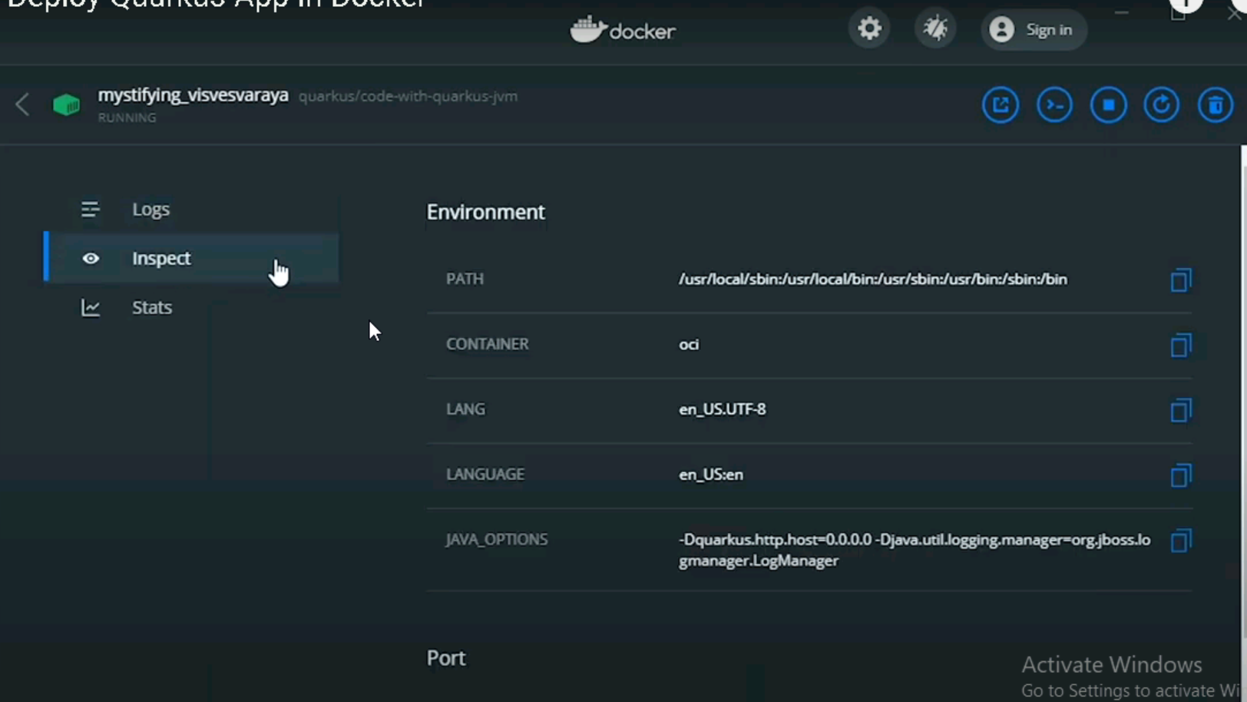

Slide 12
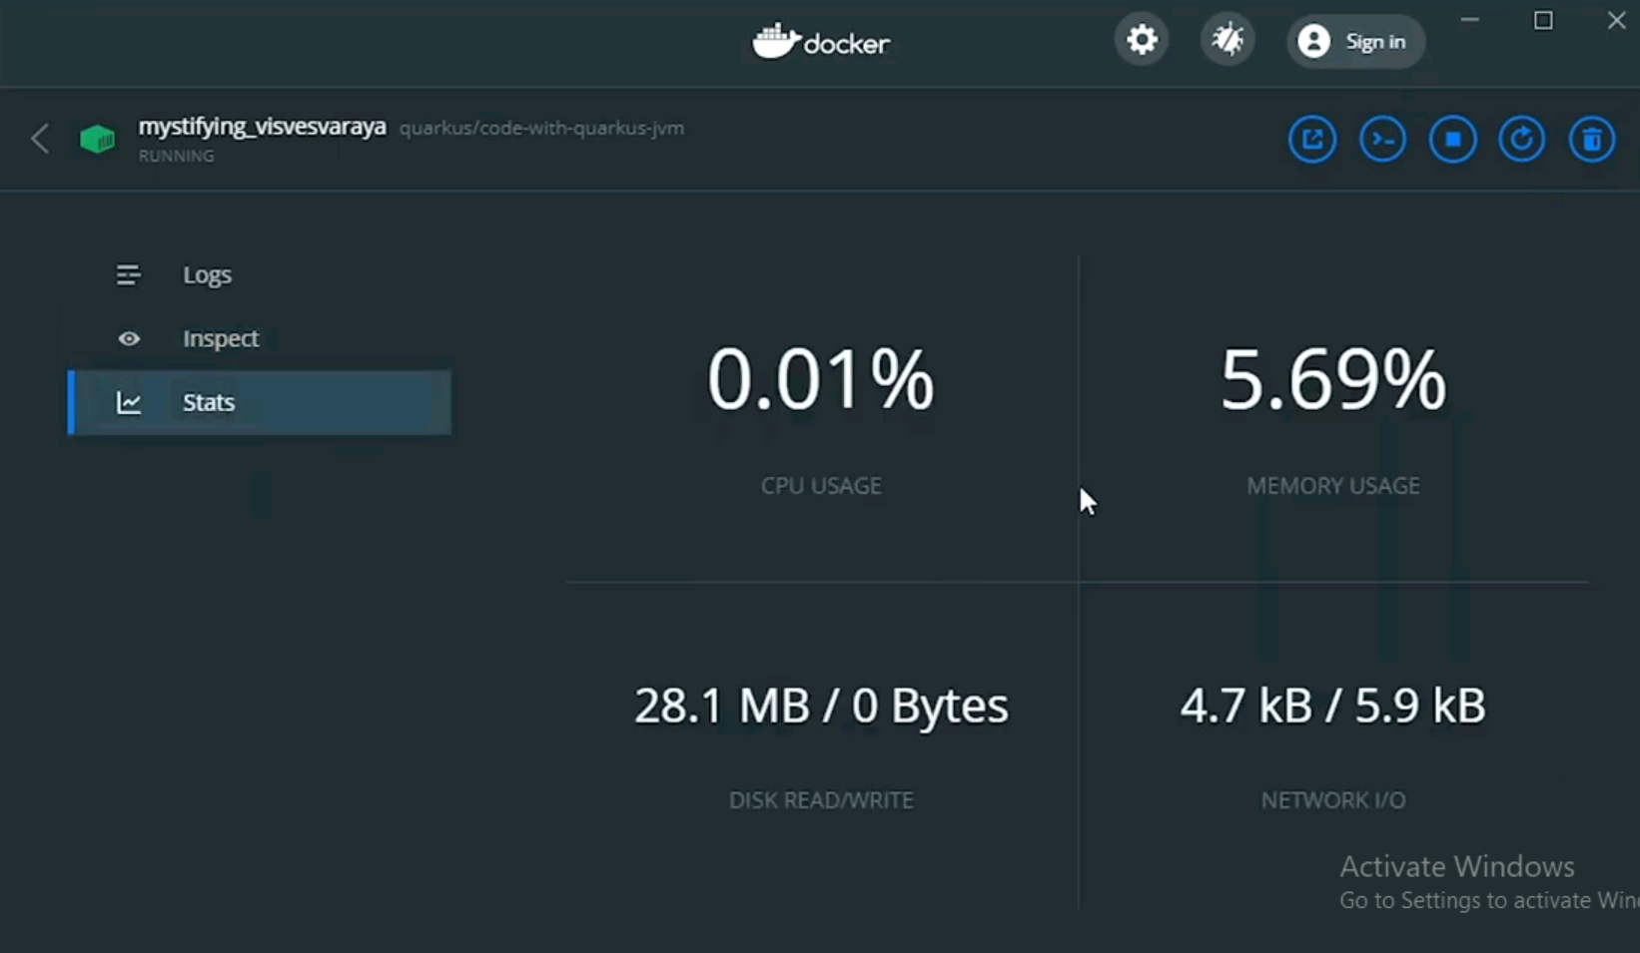

Slide 13
References
Code on Github: http://bit.ly/31BRTiM
Link: http://www.dailycodebuffer.com/

Slide 14
THANK YOU

